Slide 1


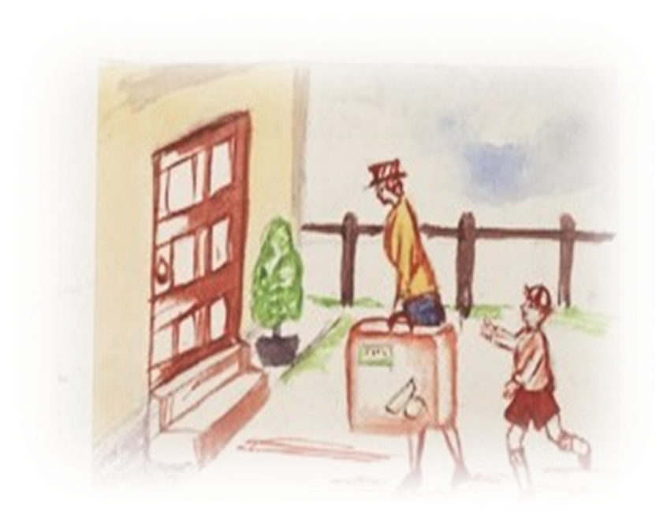


Notes:
Illustration from DHC -W-19-1 p130 – Verwood.
Q’s for the children – no hands, conferring allowed
Dates for WW2
How long ago is that? 85 years – does anyone know an 85 year old? So, its within ‘living memory’, but obviously, not many people can remember much now.
I expect you know that Britain and Germany were fighting, but each of them had ‘allies’. Who were the allies of the British? (France, US, Soviet Union) who were the allies of Germany? (Japan, Italy). Also we were helped by fighters from occupied Poland, France, Belgium, Norway. So many countries were involved, not only in Europe, but in the Far East and colonial territories in N Africa – this is why it’s a World War.
You’ve been thinking about the experiences of children during the war. Dorset was a relatively safe county in a relatively safe country, but in the UK and across Europe children were displaced by fighting and bombing. We see this happening in wars today – people fleeing with very little. And of course, sadly, many children were killed or injured and many lost their families.
Today we’re ging to look at some of the evidence we can consider for WW2 in archives. If we want to be historians, and understand the past, we always turn to evidence.

Slide 2
How do we know about the Second World War?
Notes:
Collect ideas onto a flipchart and sort into primary and secondary sources. Include newspapers, letters and cards, account books, regimental diaries, diaries, photographs, film, recordings

Slide 3
Evacuation to Bournemouth explained – a recorded primary source
Listen to John Young. When World War Two broke out he was working for Bournemouth Council in the Education Department, much as people do today. He was recorded, reading his memories, in 1994. How long ago was that?
Work on the questions quickly, and in pairs or 3’s
Notes:
After listening, children have a sheet with 7 short questions. Answer these in pairs – 3 mins tops, before discussion

Slide 4

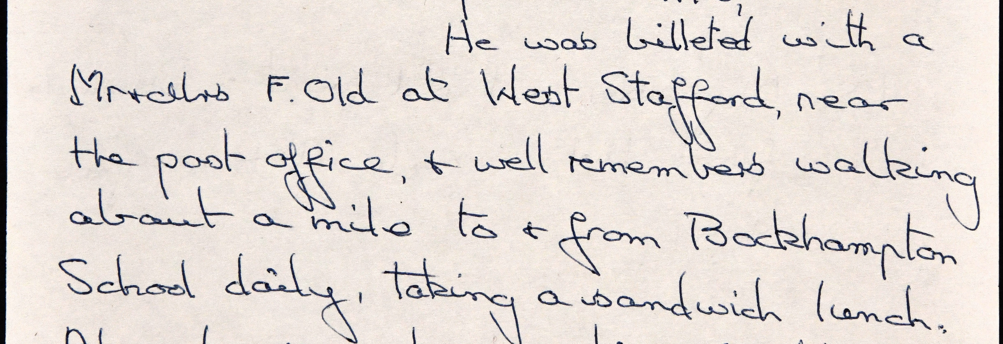
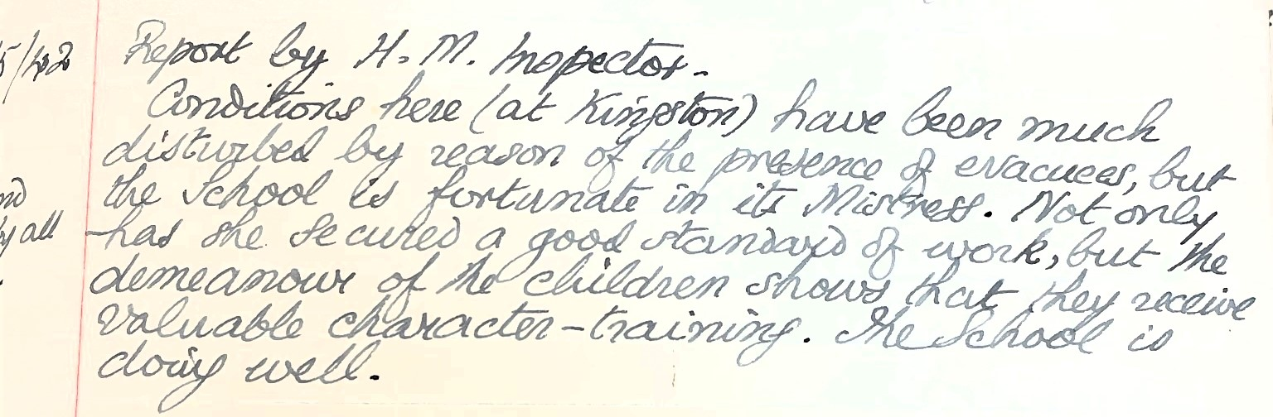
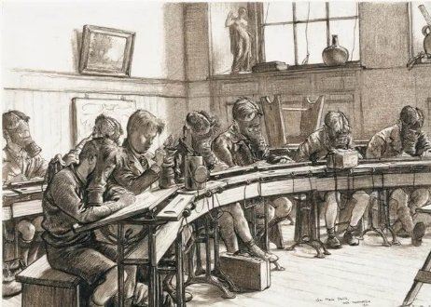
Evidence about School
Schools in rural areas remained open but often had to share their facilities with the evacuees.
This meant a double shift system.
Local children used the classrooms in the morning while the evacuees would attend school in the afternoon. Saturdays were often included.
‘1940 was a hard one but as we sometimes couldn’t get to school we enjoyed snowballs on the frozen water meadows with the local children who were friendly but called us ‘Vakies’
Rosemary Taylor
A 1941 drawing by Alex Macpherson of a class of children wearing gas masks
Notes:
A 1941 drawing by Alex Macpherson of a class of children wearing gas masks
© IWM ART LD1217
DHC DSA/168/2/2 Rosemary Taylor
D-2571-8 Kingston School Minute Book

Slide 5
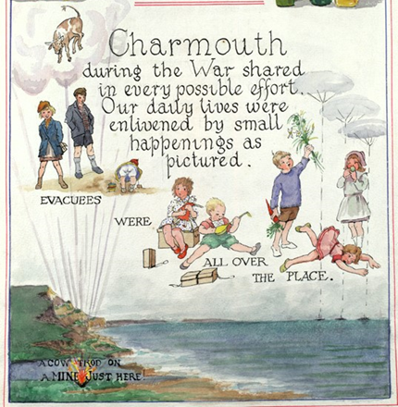
The Women’s Institute War Record Book – handwritten or typed primary source
This delightful image from Charmouth Womens’ Institute Records, mentions the ‘small happenings’ in Charmouth
Can you identify what they are?
Notes:
DHC - WI -19 Charmouth p 33 – a book made by women to show what they did and saw during World War Two.
‘small happenings’ ;
Evacuees arriving
Playing instruments, singing and homemade toys made with boxes
Gardening for vegetables
Falling down
‘A cow trod on a mine just here’ – what are mines?
What do you notice about the boys’ clothes? Yes, all boys up to about 13 wore short trousers all year

Slide 6
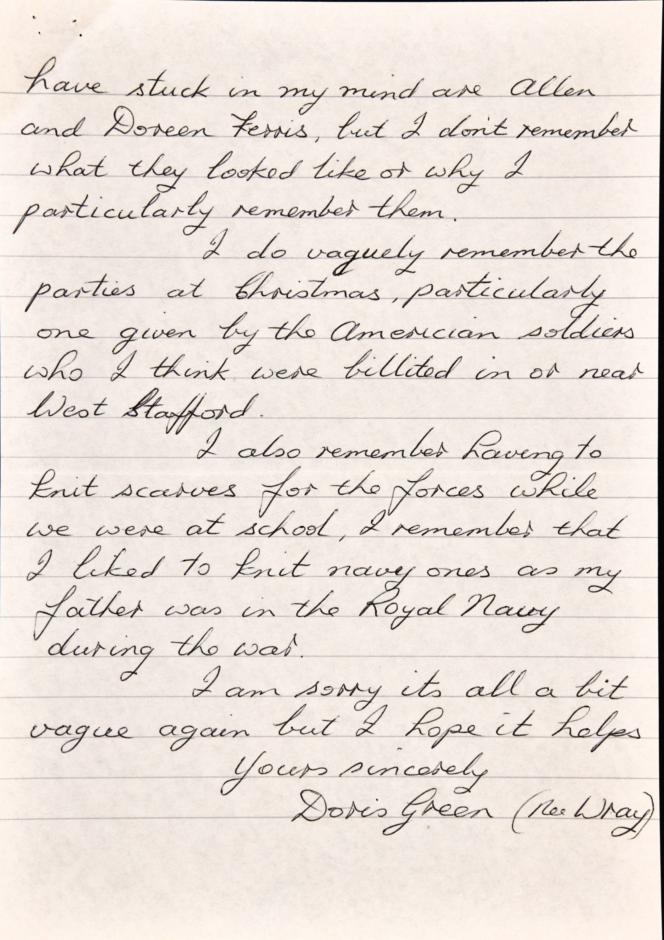
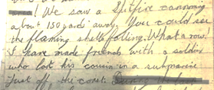

‘They had all the fields to play in and most of the, I say half the houses that are in Motcombe today were not here then, it was just fields and we could play in the fields. We’d help with the haymaking because we had double summertime at that period so the evenings were very light’
Edna Bolton
How do we know about Evacuees’ experiences?
We saw a Spitfire coming about 150 yds away. You could see the flaming shells falling. What a row! I made friends with a soldier who lost his cousin in a submarine just off the coast.
Notes:
Four primary sources cared for at DHC. – discuss how each was made, and for what purpose.
D-2571 -8 Letter about parties from Doris Green (nee Wray) to Kay Kearsey
D-3370 Letter about seeing a Spitfire from Harry Wilson to his mother.
Dorset Daily Echo Clip 4th Transcription:
September 1939
When one little six year old was being tucked up in bed on Saturday night, he asked his new ‘Daddy’ if there would be any aeroplanes over during the night.
‘No my sonny’ was the reply, ‘ you needn’t worry about aeroplanes here. You go to sleep; you are quite safe.’
Oral history interview transcript DSA S5 Edna Bolton

Slide 7
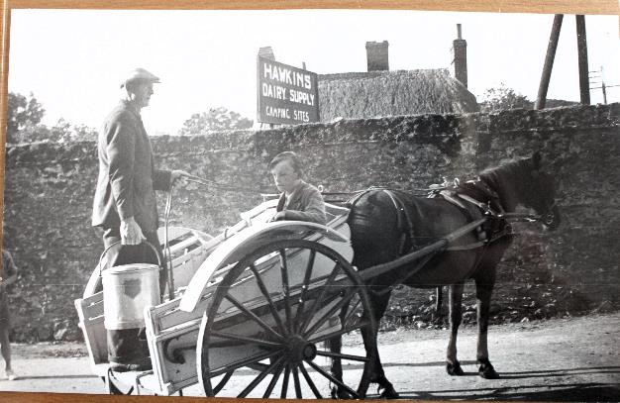
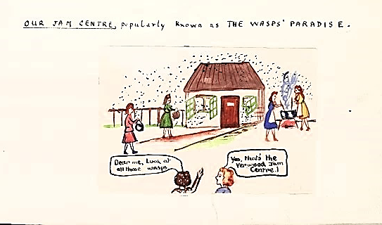

Listen carefully to the audio clip
Horse and cart milk delivery
Dear me, just look at all those wasps
Yes that’s the Verwood Jam Centre!
Notes:
Listen the clip DSA 5
DHC - D -0233 Image: Horse and cart delivery milk
Complete Worksheet Home Management

Slide 8
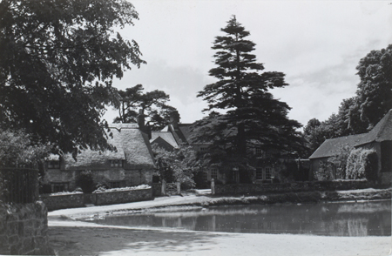
Evidence about food – listen to our short collection.
Motcombe Village, about 10 years after the end of World War Two.

Slide 9
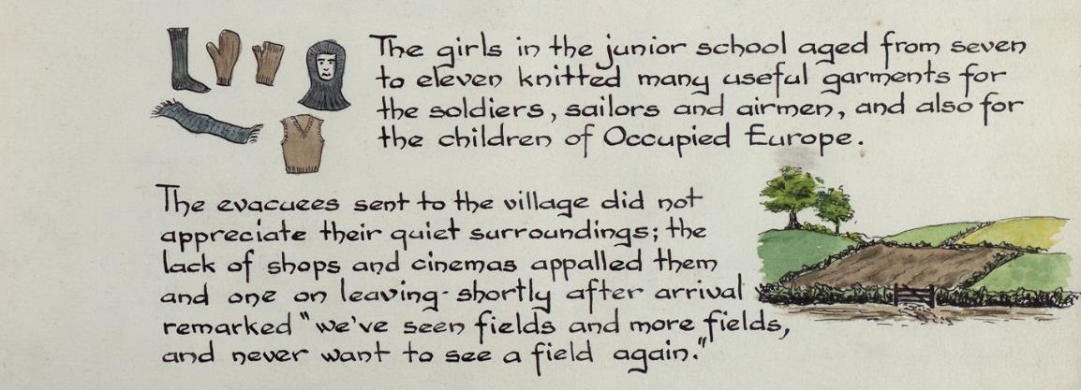
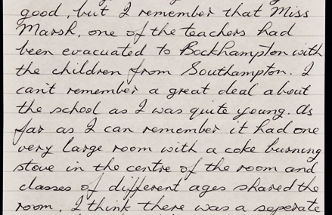
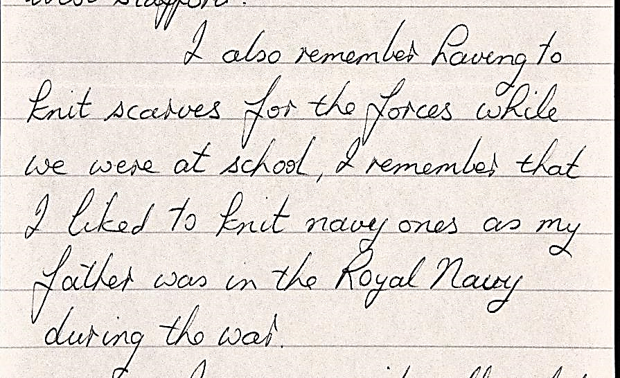
What information can you identify from the letters and journal ?
Notes:
D- 2571- 8 Letter from Kay Kearsly to Doris Green
DHC – WI- Holywell
D-2571-8 Robert Clarke to Kay Kearsley

Slide 10
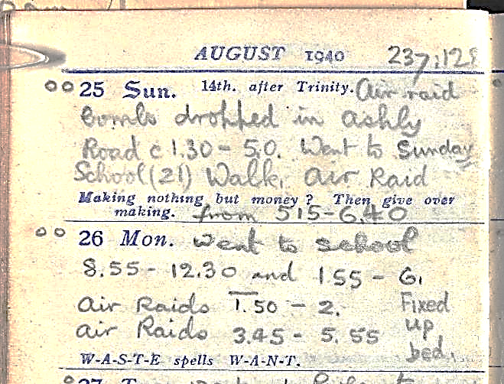

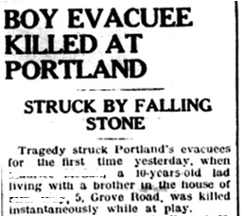
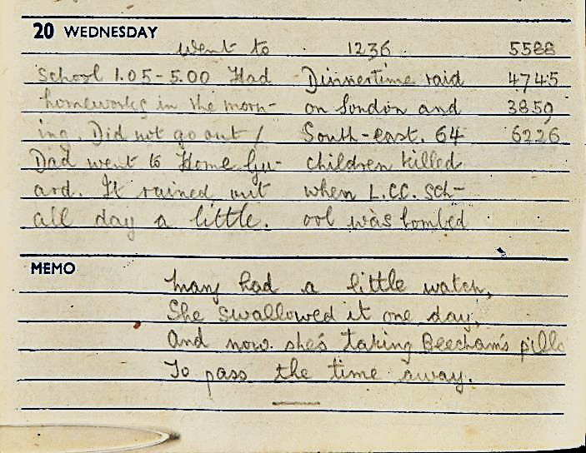
August 1940
Sadly, not all the experiences encountered in the rural areas were secure or safe.
How long do the air raids last?
(Norman Gale Diaries)
January 1943
London Raid, school casualties
Notes:
DC-PL/1/5/1/5 Norman Edwin Gale -Diaries
Newspaper Clip- Dorset Echo 29th March 1940

Slide 11
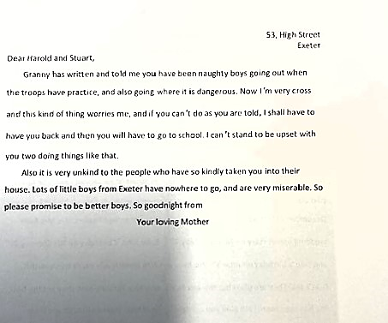
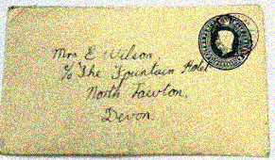
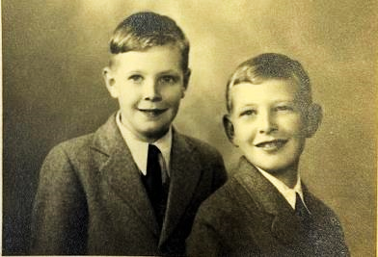
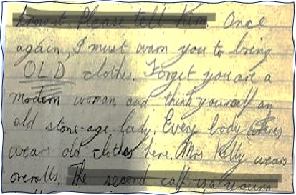
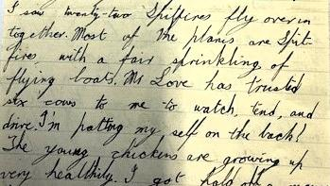
Writing Letters
Letter from Harold’s mother remarking on his behaviour. Mrs Wilson was billeted in a hotel and continued working in Exeter
Harold and Stuart Wilson evacuated from the Exeter Blitz to Martinstown, Dorset.
Examples of Harold’s letters to his mother
Notes:
Once again, I must ask you to bring OLD clothes. Forget you are a modern woman and think yourself an old stone age lady. Everybody working here wears old clothes. Mrs Kelly wears overalls
DC-PL/1/5/1/5 Norman Edwin Gale -Diaries

Slide 12

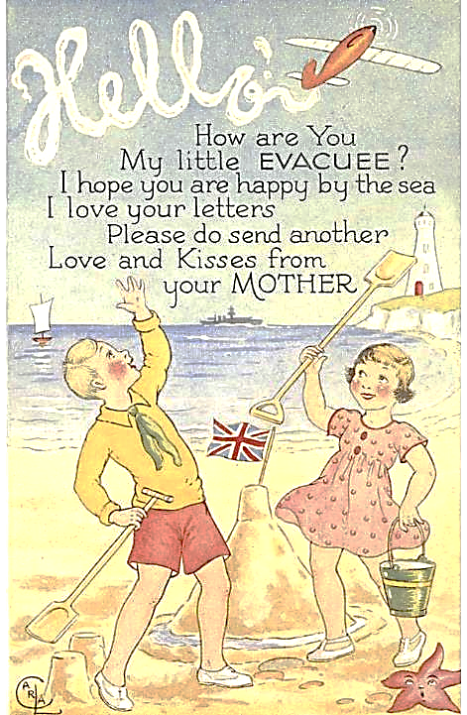
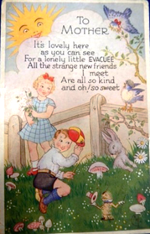
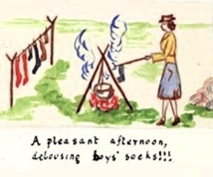
1. Reflecting on the information you have briefly seen in the lessons, can you think how you may have felt under the circumstances.
Use your thoughts and discussions to create a piece of work which may be in the form of a letter, poem, post card or diary entry.
Use the inspiration of the images and letters from the Dorset Archives to illustrate you own work.
You could consider the different points of views. Hosts, Parents, Happy or Frightening.
2. Complete the ‘Wordsearch’
Postcards provided for parents and children to send
A pleasant afternoon delousing boys socks !!!
Notes:
Wordsearch doc

