Slide 1
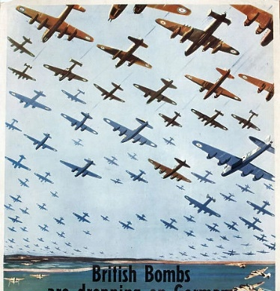
Children of the Second World War 'Evacuees’
1 September 1939 – 2 September 1945
Dorset
Look out for  to remember important words
D-W-19 the WI War Record Book
Notes:
DHC - W-19-1-p130- Verwood ‘Recollections of our Billeting Officer’

Slide 2
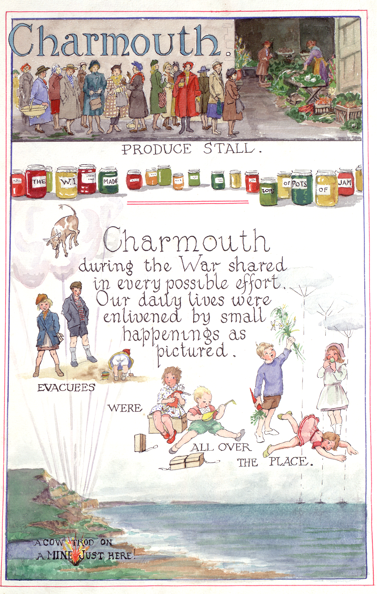
EVACUEES 
What are they ?
Definition:
- someone who has been sent away from a dangerous place to somewhere safe, especially during a war Collins Dictionary
Notes:
How do we know about the children evacuated to Dorset? DHC cares for many sources including maps, photos, diaries and newspapers. This image is from a very special book – the Women’s Institute War Record book, which tells us about all the things women did during the war. Look carefully at this image from the Charmouth pages. What do the pupils notice?
In the top panel women are queuing to buy fruit and vegetables. Under that are the jam jars- jam was a great way to preserve the fruit harvest. Can you read the labels on the jars? The main picture shows the evacuees, described as ‘small happenings’. How many evacuee children can you see? Which do you think is the youngest and which the oldest? What things can you see the children doing? How do you think the woman who painted this picture felt about the evacuees?

Slide 3
Why was there evacuation
in World War 2 ?
German bombing raids were aiming to destroy important places in the UK connected to military activity in some way, for example:
factories making aircraft or military bases and airfields.
Britain bombed German cities too and German children were also moved to the countryside.
On the 3rd September 1939, World War II was declared in Europe
Evacuees were sent to rural and neutral areas, less likely to be targets.
recording of chamberlains declaration of war broadcast - Google Search
Notes:
1. Do you know any countries that are in Europe ?
2. The word Luftwaffe means ‘Air Weapon’
3. Do you know what the number is given in the information, of the children who were evacuated ?
4. What do you see in the photo ?
6. What does declared mean?
7. When did Evacuation end?
From September 1944, the evacuation process was officially halted and reversed for most areas except for London and the east coast. Returning to London was not officially approved until June 1945. In March 1946, the billeting scheme was ended, with 38,000 people still without homes.
https://www.google.com/search?q=When+did+evacuation+in+WW2+end&oq=When+did+evacuation+in+WW2+end&gs_lcrp=EgZjaHJvbWUyBggAEEUYOTIHCAEQIRigATIHCAIQIRigATIHCAMQIRigATIHCAQQIRigATIKCAUQIRgWGB0YHjIKCAYQIRgWGB0YHjIKCAcQIRgWGB0YHjIKCAgQIRgWGB0YHjIKCAkQIRgWGB0YHtIBCTExNzQzajFqN6gCALACAA&sourceid=chrome&ie=UTF-8
Evacuation – areas where heavy bombing was expected.
Neutral – areas that would not need to send or receive evacuees.
Reception – rural areas where evacuees would be sent.

Slide 4
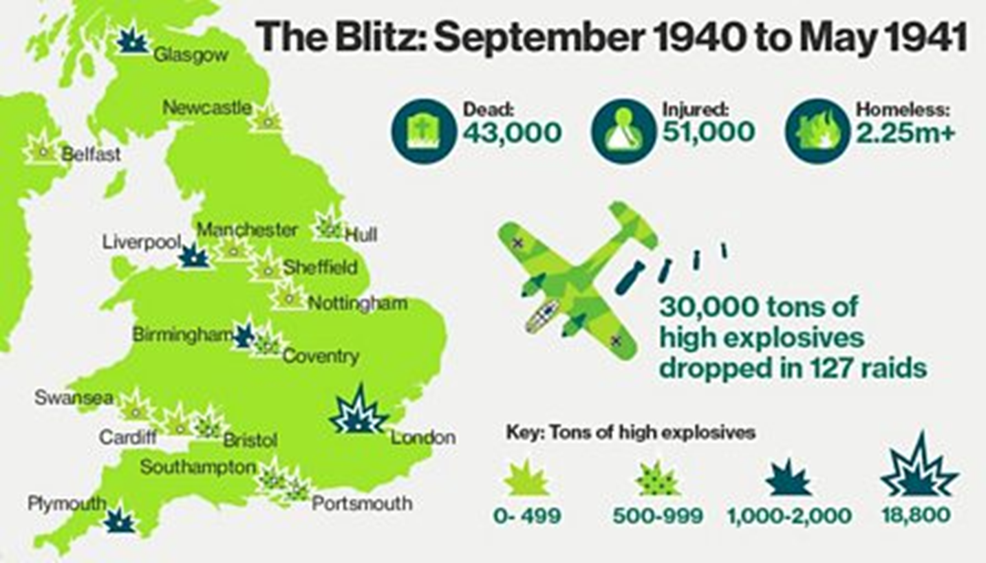
What was
The ‘Blitz’ ?
The heavy and frequent bombing attacks on London and other cities was known as the 'Blitz’.
Night after night, from September 1940 until May 1941, German bombers attacked British cities and ports.
London was bombed every day and night, except one, for 11 weeks.
One third of London was destroyed
When the German Bombers were spotted you would have heard this Air Raid Siren
Notes:
1. Can you think how it would feel to have bombs being dropped near your home every day and night for 11 weeks?
2. How many months is that ?
3. Look at the map, which bombed cities are closest to Dorset?
4. look at the key- which UK city had the most explosives dropped on it?
https://www.historyextra.com/period/second-world-war/persuading-the-people-british-propaganda-in-the-second-world-war/

Slide 5
Many civilians including children died during this time
43,500 civilians died in the 7 months between September 1940 and May 1941, almost half of them in London.
During the 8-month attack
7,736 children were killed.
Many lost relatives, including brothers or sisters. Others were orphaned. 7,622 were seriously wounded
Out of the final total of 61,715 civilians killed or mortally wounded, there were the following by age:
2 years = 1,230
2–15 years = 7,180
16–17 years = 1,922
Notes:
1. 43,500 is equivalent to the population of Salisbury or Winchester
https://worldpopulationreview.com/countries/cities/united-kingdom
Roughly 40,000 civilians have been killed in Gaza in approx. 9 months
2. Can you add together the number of children killed or seriously wounded ? Why are there more cjildren killed in the 2-15 age group (more years included)
3. What are your thoughts on this ? How does this make you feel?
Civilian - In a military situation, civilian is used to describe people or things that are not military. (Adj)
Mortally - causing death (adj) Mortal (n)

Slide 6
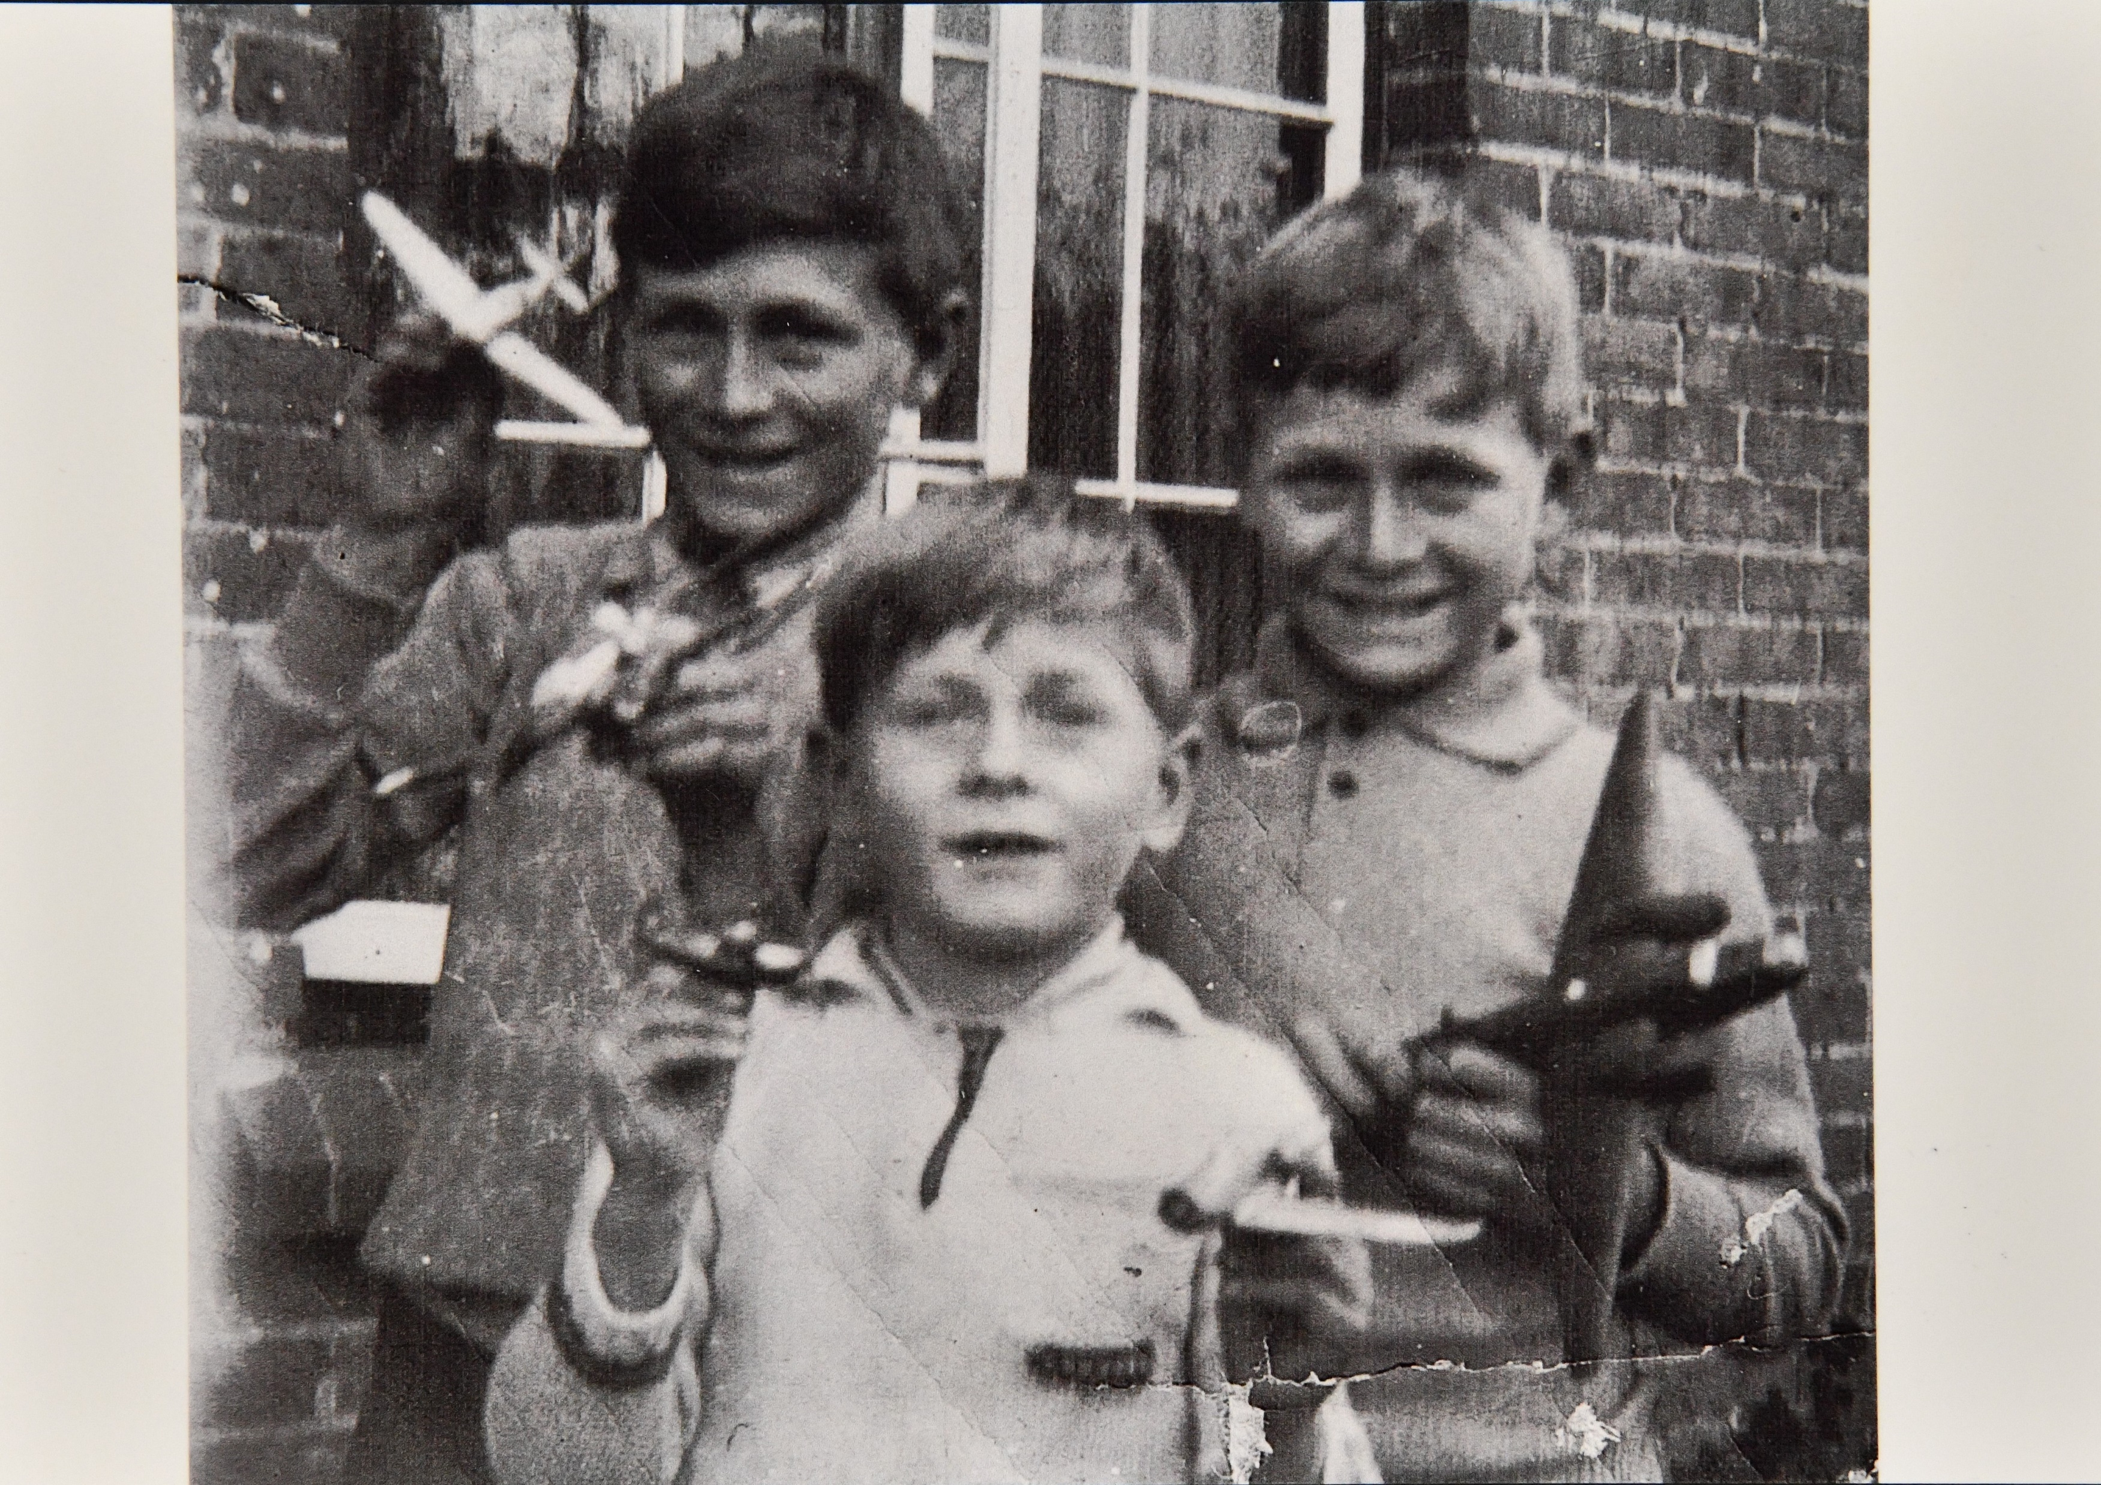
THE EVACUATED
Who were they ?
Evacuees were split into four groups which were not essential to war work
1) School-age children;
2) Some disabled people
3) Pregnant women
4) Mothers with babies or pre-school children (who would be evacuated together)
s
The first evacuation was called:
OPERATION PIED PIPER
D-2571 boys evacuated to West Stafford in Dorset
Notes:
What does ‘non–essential’ mean
Who do you think ‘essential’ people were ? Make a list.
Why were they essential ?
Were there any essential jobs in the countryside ?
Work sheet ‘Operation Pied Piper’
Image DHC - D-2571

Slide 7
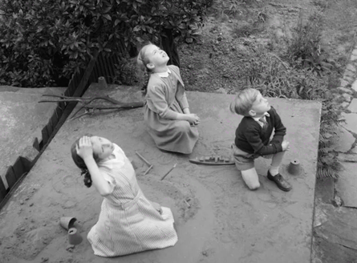
Cardiff
Ports, Docks, Major Cities and Industrial Areas in the UK which were targets for German Bombing Raids
Clydebank
Birmingham
Sheffield
Bristol
Portsmouth
Manchester
Liverpool
Plymouth
London
Hull
Belfast
.
Notes:
1. Complete the Map Exercise 1
‘Where did the evacuees find homes in Dorset ?’
2. Can you find the Docks and Ports on the Map?
Image - Children sitting on an air raid shelter watch aircraft pass over their garden in 1944. © IWM D20623

Slide 8
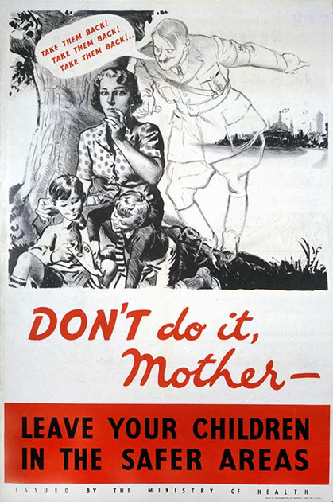
Poster displayed at the beginning of the war
What do you think the poster is telling us ?
Evacuees_DSA_5_clip1a.wav
(In the clip, listen out for Edna mentioning the ‘Phoney War’
Notes:
1. Who are the posters aimed at?
2. Why do you think mothers wanted to take their children home?
3, Who is the ghostly figure whispering ‘Take them back!’?
4. Hitler, who was Hitler?
5. Where is he pointing?
6. What does he want the mother to do and why?
7. Why might this mother be tempted to ‘Take them back’?
8, What ideas do you have for a Poster warning parents about staying in the cities?
Listen to: DHC - DSA 5 clip.a.wav Transcript

Slide 9
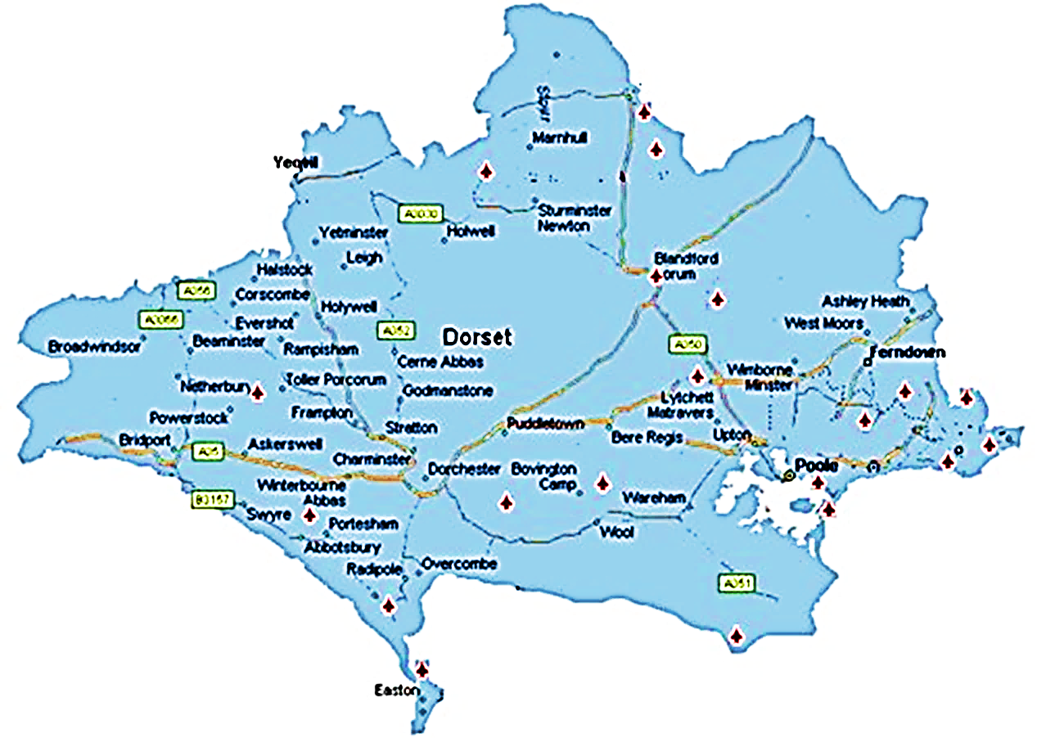
Dorset
Places (sites) where German Bombers and British fighter planes crashed. • Can you see the tiny aeroplanes on the map?
Do you recognise any of the places on the map ?
Notes:
1. Using Map Exercise 2 :
1. Can you relate and mark the sites of aircraft lost, to:
a) places you have found
b) the children evacuated
2. Why do you think they were flying in this area ?
(e.g. On the way to the Docks, Bristol)

