Slide 1
DiSC
Dorset Information Sharing Charter
Helen Cheleda

Slide 2
Background
Initiated by Better Together programme
Improve information sharing for patients, residents and service users
Ensure a collaborative approach with an overarching governance and quality assurance
Widen membership to include GPs, 3rd sector and emergency services
Overarching Information Sharing Charter (OAISP) needed a review
Out of date without continuous governance and quality assurance
Decision process at highest level of authority
DiSC launched January 2015 endorsed by the ICO and fully supported across Dorset
Notes:
BT – integrating health and social care services
GPs are data controllers – valuable information
OAISP lost its way – no ongoing governance
Executive risk adverse to decision making
DiSC launch – approx. 250 at executive level – ICO, Centre for excellence and HSCIC
OAISP now decommissioned – DiSC only Information sharing agreement for partners

Slide 3
DiSC Principles & Commitments
Principles ensure members
Have a lawful basis for sharing
Security of the information
Use PISAs at point of need
Encourage sharing and promote best practice
Are protected from unlawful use of personal data
All members must adhere to the charter’s commitments
Applies to entire organisation
Have a nominated IG Lead
Ensure staff are properly trained and are aware of legal requirements
Develop and review PISAs
Follow Caldicott and DPA principles
Ensure appropriate policies and procedures are in place
Contribute to Pan Dorset best practice for information sharing initiatives
Notes:
Intent to share at highest level – not detail
Charter document – view key principles and committments

Slide 4
Pan Dorset Decision Framework
Pan Dorset IG Group
3 LAs
Dorset, Bournemouth & Poole
3 Hospital trusts
Dorchester, Poole & Bournemouth
Dorset CCG
Dorset Healthcare
Dorset Police
SWAST
Dorset & Wiltshire Fire
Notes:
Discuss Tiers and decision making process
5-10 yrs prior to review
IG group members and roles – ToR, Meet monthly, quality, advice and guidance

Slide 5
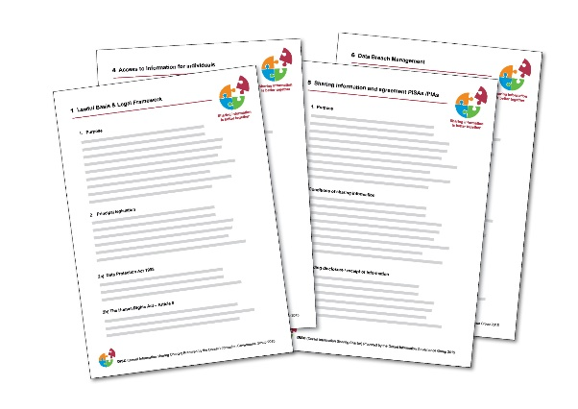
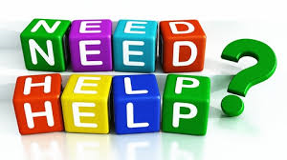
Resources
Templates
Practitioner Guidance Documents
www.dorsetforyou.com/disc-members
Resources to raise awareness
Help and support

Slide 6
Members
Currently DiSC has over 100 members
Core Members – LAs, Trusts, Blue Light Services
All GPs
Voluntary Services
Schools and Pre Schools
Members have:-
Access to guidance documents and universal resources
Attend workshops and awareness events
Contribute to Pan Dorset IG Group and joint development
Benefit from help and support
Notes:
1. Foundation for DCR

Slide 7
Questions?

