Slide 1
Wessex Resolutions CIC
Martine Bryant and Ellie Lister
Loans Advisers
martine.bryant@wrcic.org.uk
ellie.lister@wrcic.org.uk

Slide 2
Who Are Wessex Resolutions CIC?
A not-for-profit, Community Interest Company
Based near Taunton, Somerset
Established 2002

Slide 3
Our Objective
To provide affordable finance to
homeowners for essential repairs, maintenance or adaptation.

Slide 4
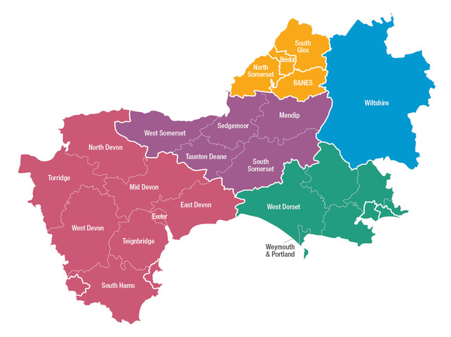

Slide 5
Loan Schemes
Home Improvement Loans
Loans to Landlords
Empty Property Loans
Park Home Loans
First Time Buyer Loans

Slide 6
How the Loan Scheme works
LA funds held by WRCIC
Capital returned to pot Funds lent to client at 4%
Interest covers WRCIC costs

Slide 7
Landlord and Empty Property Loans
Essential repairs and modernisation
Improve EPC rating
Renovate to Rent
Renovate to Sell
Renovate to Reside

Slide 8
Loan Products
Capital Repayment
Deferred Capital Repayment
Other loan products available – depends on client needs

Slide 9
Amounts and Term
Minimum loan - £1,000.00
Maximum loan - £15,000.00
Term ranges from 1 year to 15 years

Slide 10
The Important Bits…
Fixed rate of 4% (Representative 4.2% APR)
No set up fees (except £20 Land Registry fee)
No early repayment fees
Variety of loan products to meet needs and means

Slide 11
Loan Protection
Equitable Mortgage
Title Restriction - Land Registry

Slide 12
Case Study
Empty for 1.5 years
Inherited
Not able to sell – un-mortgagable
Worried about meeting additional Council Tax demands
Repayment deferred for a year
Works are now nearing completion

Slide 13
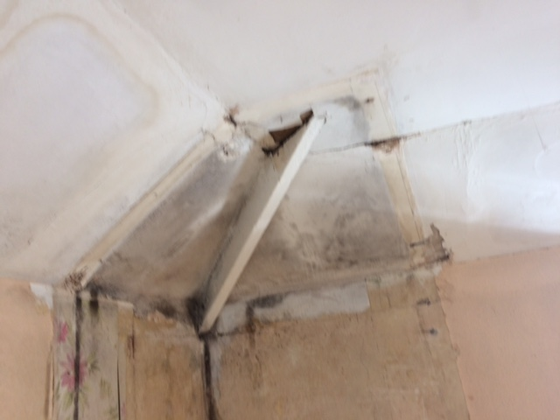

Slide 14
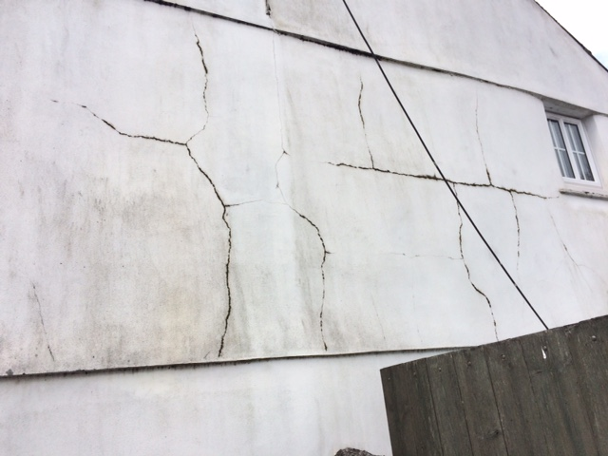

Slide 15
Why Wessex?
Client focused
Solution focused
Flexibility
No set up fees or early repayment penalties
Extra support during application process for those who need it
Local Authority funded

Slide 16
Any Questions?
Wessex Resolutions CIC

