Slide 3
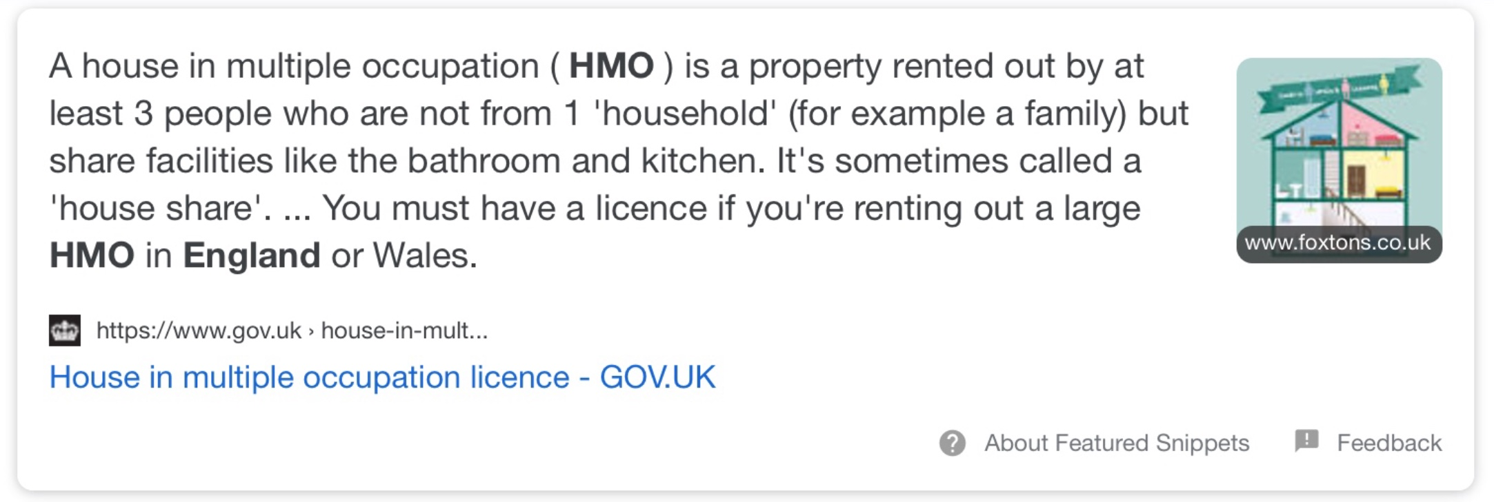

Slide 5
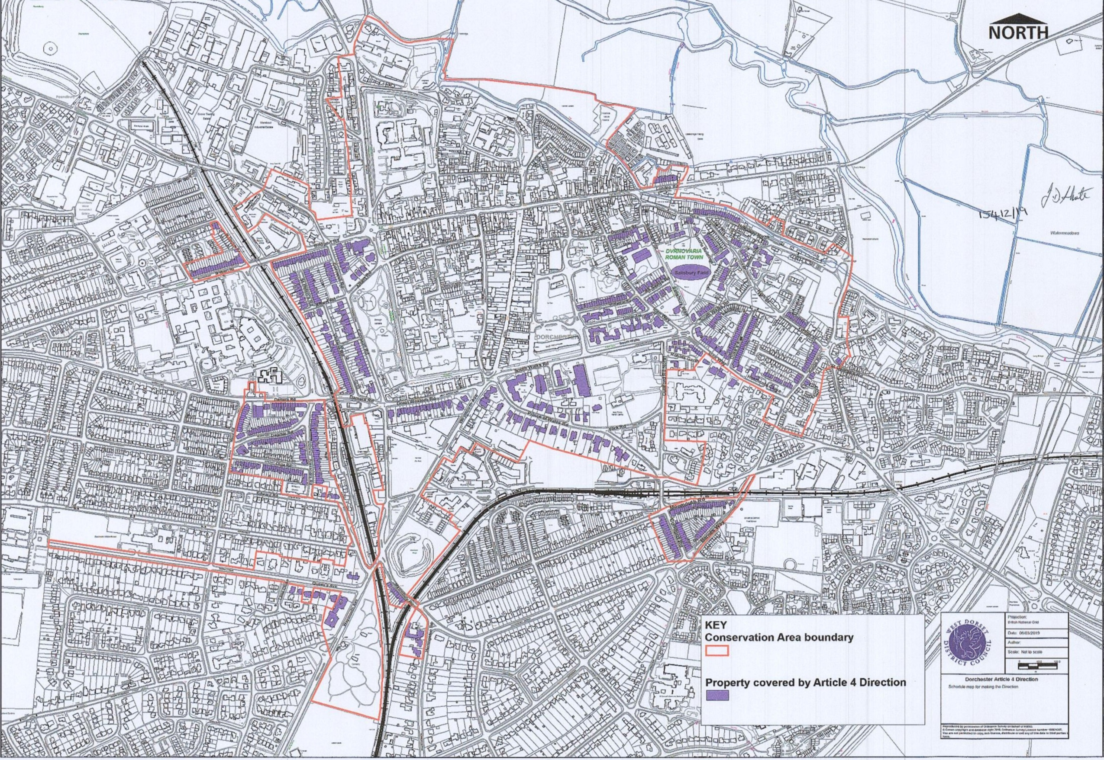
ARTICLE 4 AREAS

Slide 7
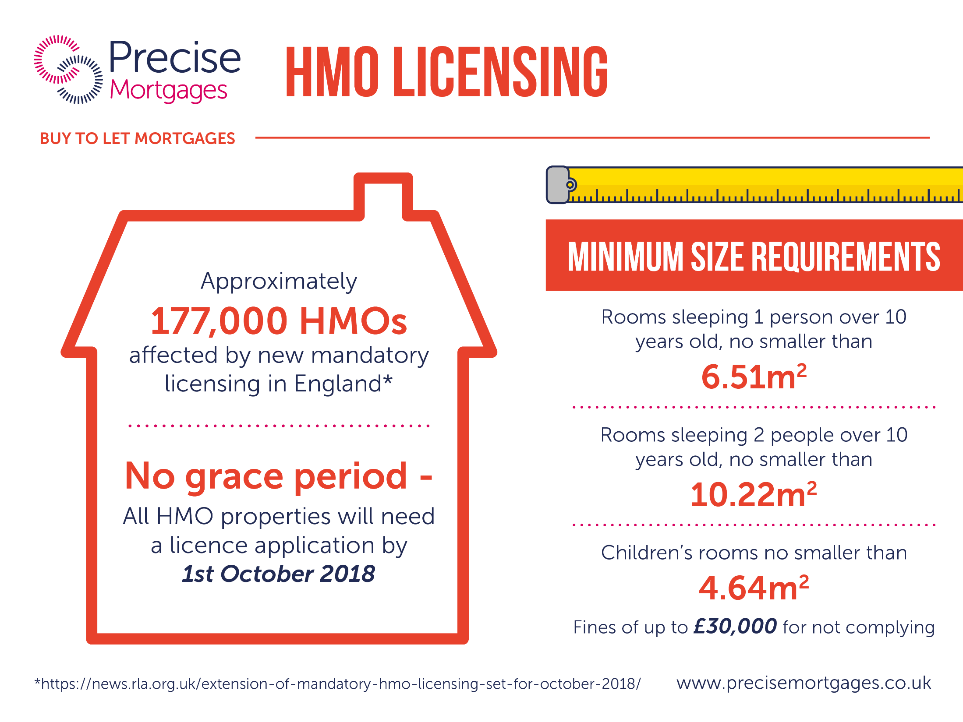

Slide 10
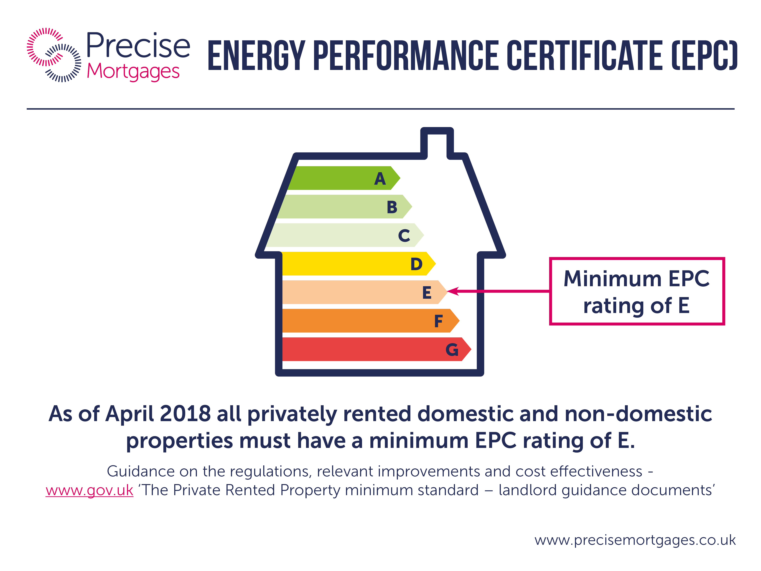

Slide 13
Notes:
REFURB TO LET
The process for the Refurb BTL is all dealt with by one experienced underwriter who will assess the deal, the schedule of works and produce terms for the entry and the exit giving you security of exit.
If the reinspection of the valuation is returned as expected and there are no changes, the case will complete on the BTL mortgage and the Bridging will be repaid.

Slide 14
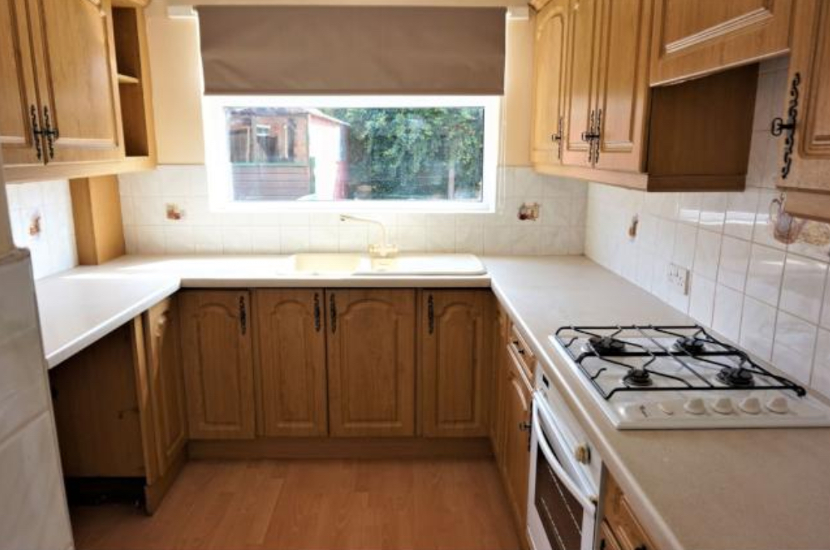
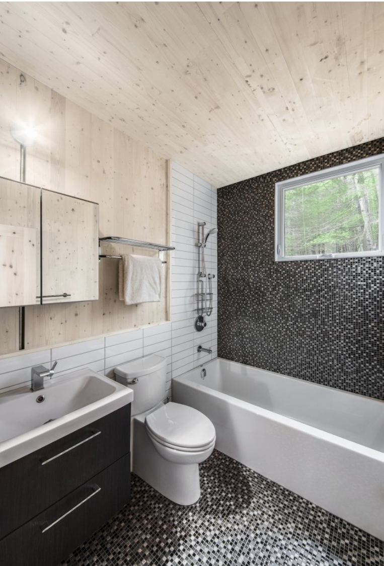
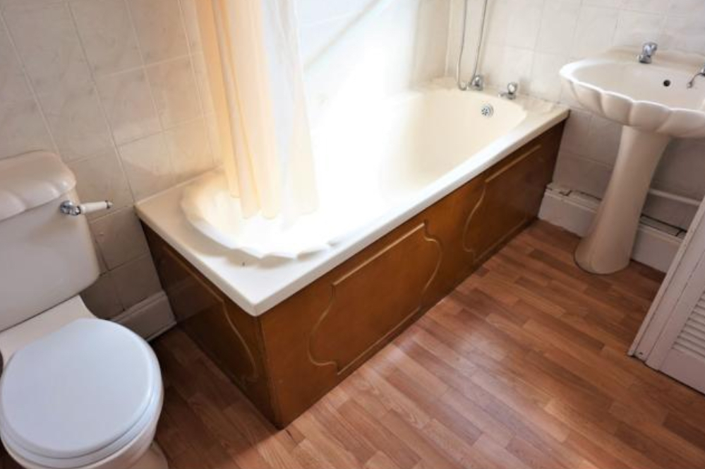
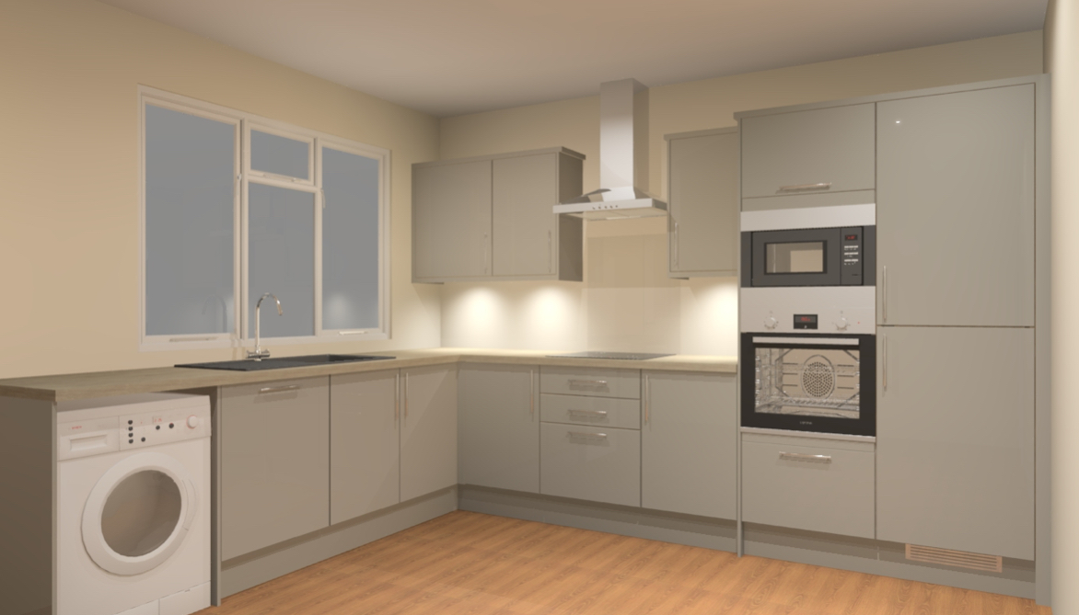

Slide 16
Simon Morrall, Business Owner – Mortgage Advice Bureau Dorset
Office number: 01305 260500
Mobile number: 07739 657911
Email: simon.morrall@mab.org.uk
Website: http://www.mortgageadvicebureau.com/Dorchester
Office Address: Suite 2, Inch Arran House, Ringhill Street, 9 Queen Mother Square, Poundbury, Dorchester, DT1 3BX.

