Slide 1
Housing Standards Richard Conway: Service Manager
Where does Housing Standards sit within Dorset Council
Update on Melcombe Regis – Selective Licensing and an Alternative Proposal

Slide 2
Housing and Community Safety Services
Executive Director People – Adults
Mathew Kendal
Housing Standards
Richard Conway
Corporate Director Housing
Rebecca Kirk
Housing Solutions
Sarah How
Community Safety
Andy Frost
Homelessness Prevention
Fiona Brown
Housing Strategy
Sharon Attwater

Slide 3
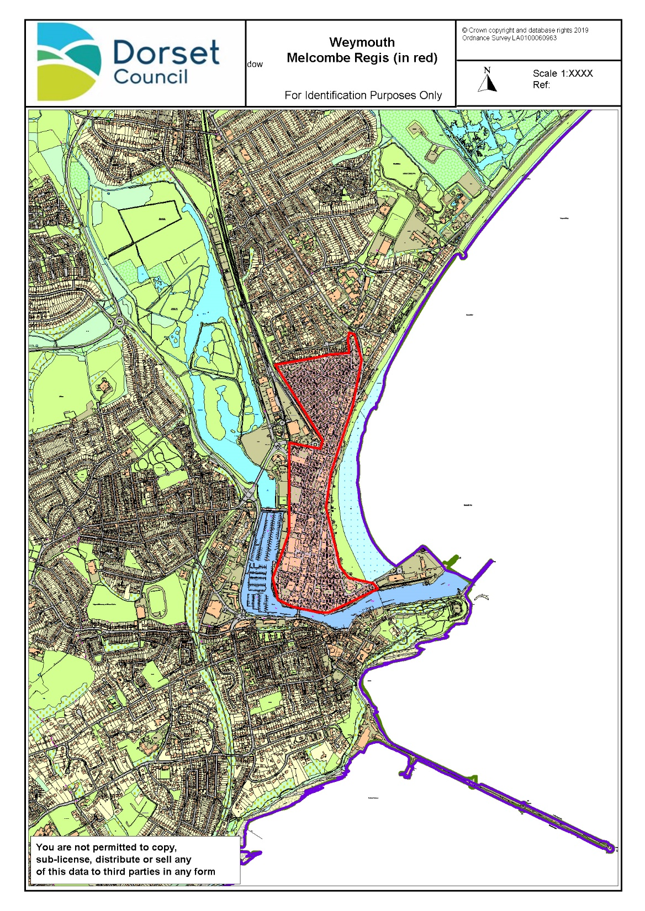
Melcombe Regis area of Weymouth

Slide 4
Selective Licensing Time line
Date | Action
April 2016 | Melcombe Regis Board established – vision: “Make MR a safe, healthy and great place to live and work”
Nov 2016 | Evidence pack produced
July 2017 | Options Appraisal of possible interventions
September 2017 | WPBC Management Board agrees to proceed with Selective Licensing.
December 2018 | WPBC Agrees to proceed with consultation.
December - April 2019 | Public Consultation
July 2019 | Consultation published
July – August 2019 | Post consultation meetings with partners
April 2019 | LGR occurs
August 2019 | Pause instigated and decision to form EAP.

Slide 5
Executive Advisory Panel Melcombe Regis
Member led group considering whether a scheme incorporating:
Voluntary Accreditation of Landlords
Targeted enforcement of landlords letting poor housing
Other schemes to improve housing standards
(Extending the Heat Melcombe Regis Scheme -Ends Nov 2020)
Would this achieve the same objective as Selective Licensing?

Slide 6
Executive Advisory Panel Melcombe Regis
DHCLG Official Guidance
“The Authority must consider if there are any other courses of action available that would achieve the same objective as the proposed scheme without the need for the designation to be made”
For example:
“In areas with Anti-Social where landlords are not taking appropriate action, could an education programme or a voluntary accreditation scheme achieve the same objective as a selective licensing designation?”

Slide 7
Executive Advisory Panel Melcombe Regis
EAP - Consult with stakeholders
EAP - Makes recommendation
Report to Dorset Council Scrutiny Committee
Cabinet Approval
Council Approval

