Slide 1
© The YOU Trust 2018

Slide 2
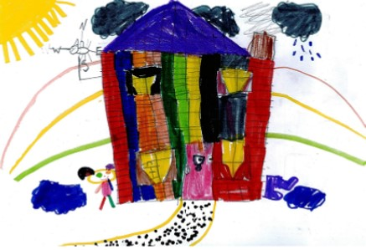
Domestic Abuse and a whole family approach
0800 032 5204
© The YOU Trust 2018

Slide 3
DV Awareness
Triggering complexities
Working with parents when the child is the instigator
Elder Abuse
You First
© The YOU Trust 2018

Slide 4
© The YOU Trust 2018

Slide 5
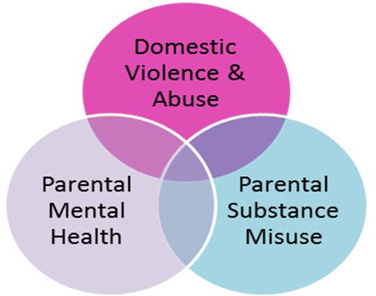
© The YOU Trust 2018

Slide 6
© The YOU Trust 2018

Slide 7
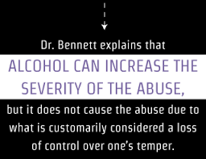
© The YOU Trust 2018

Slide 8
© The YOU Trust 2018

Slide 9
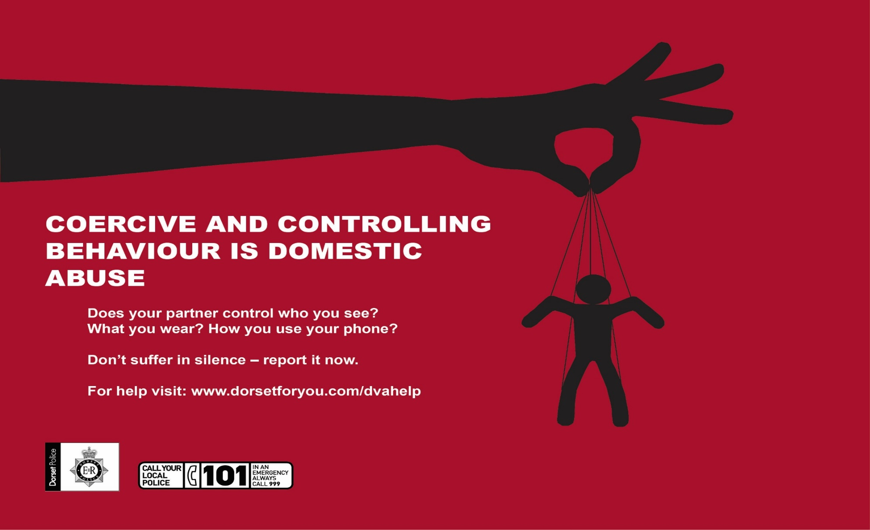

Slide 10
Affects on parenting capacity
Unpredictable environment for children
Lack of emotional warmth
Respond to fear and anxiety of the parent/carer being abused
Increased risk of harm
Can cause a parent to be hostile, withdrawn
© The YOU Trust 2018

Slide 11
“Time and again, it seems that the combination of problems is much more likely to have a detrimental impact on children than a parental disorder which exists in isolation” Cleaver et al (2011)
© The YOU Trust 2018

Slide 12
The majority of children witness the violence that is occurring, and in 90% of cases they are in the same or next room (Hughes, 1992).
Witness DA
Caught in the middle
Hear the abuse
Physical injuries
Not allowed to play
Forced to witness
Children can experience both short and long term cognitive, behavioural and emotional
© The YOU Trust 2018

Slide 13
Best Practice
Working with the family
Working in partnership with specialist providers
Understanding risk in context
Sharing whole family assessments
Engaging the whole family
© The YOU Trust 2018

Slide 14
Adolescent to Parent Abuse
How does this fit with ‘domestic abuse’
‘‘any act of a child that is intended to cause physical, psychological or financial damage in order to gain control over a parent’’ Cottrell 2004
© The YOU Trust 2018

Slide 15
Adolescent to Parent Abuse
‘‘a pattern of behaviour that uses verbal, financial, physical or emotional means to practice power and exert control over a parent’’ Holt 2013
© The YOU Trust 2018

Slide 16
Adolescent to Parent Abuse
Considerations
Parents (victims) have legal responsibility
Who leaves when it gets too bad?
What threats are used to stop reporting?
Social resistance – who will believe it
© The YOU Trust 2018
Notes:
A consequence usually is that the victim can not leave the perpetrator in a way that may be possible in an adult relationship.
Will the young person have to leave the family home
Is it in the best interest of a child to have a legal order or court injunction
Threats by the child are used regularly to stop the parent reporting – ‘I will phone social care and say you are a rotten parent’, ‘I cant believe you are going to tell the police about me, I thought you loved me’ – very strong and powerful statements that are designed to stop a parent reporting.
There is still a strong social resistance to believing that children are capable of instigating abuse and terrorising their families.

Slide 17
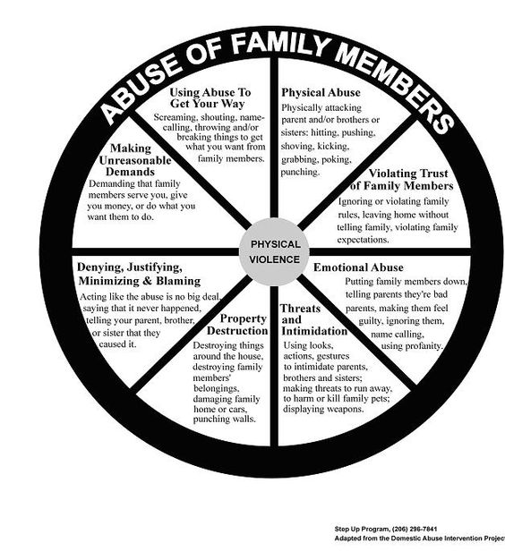
Adolescent to Parent Abuse
Ways forward
ACE’s
Who’s in Charge
Recovery Tool kit
Step Up
© The YOU Trust 2018

Slide 18
Elder Abuse
“It is important to recognise the reality of elder domestic abuse and respond accordingly. The issue is about the actions of the perpetrator, not the characteristics of the victim. This means that responses should not be medical or social based, but should be focused on the criminal nature of the acts”
© The YOU Trust 2018

Slide 19
Elder Abuse
Sexual – can be committed against an incapacitated person who is not competent to give informed consent
Emotional – such as threatening to place in care home, isolation from family
Depriving access to information
Power of Attorney
© The YOU Trust 2018

Slide 20
Elder Abuse
Separate out the deliberate abuse
Additional issues to consider
Who lives/has access to the house
Looks for signs to guide interventions
Age does not matter, domestic abuse affects all ages
© The YOU Trust 2018

Slide 21
© The YOU Trust 2018
Notes:
Katie

Slide 22
“We know that communities are often the first to know about abuse, and that they can act as gate openers or gate closers in terms of help seeking.”
(Finding the Costs of Freedom report, 2014)
© The YOU Trust 2018

