Slide 1
Neglect and Self-Neglect in Adults and Children
Wendy Thorogood – Dorset CCG
Designated Nurse Consultant for Safeguarding Children
Verena Cooper – Dorset CCG
Designated Adult Safeguarding Manager

Slide 2
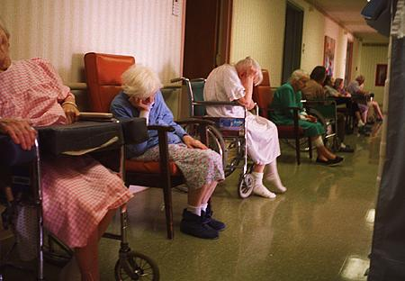
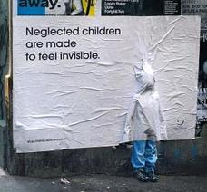
Every one will have their own view on what
Neglect / Self Neglect is…….

Slide 3
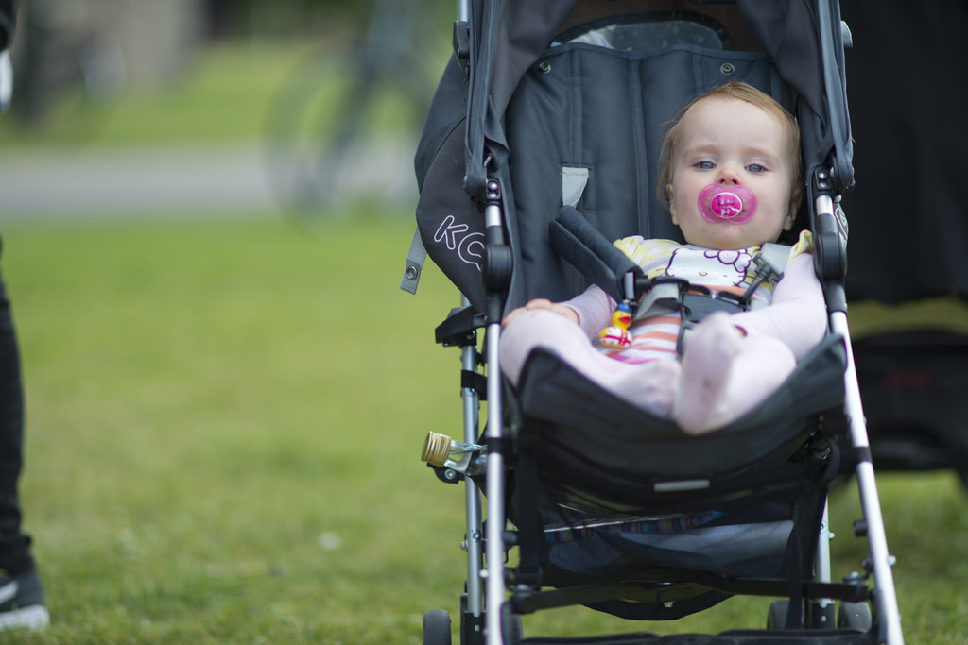
Let me tell you a story about Baby Bell

Slide 4
Grandmother aged 72
(main carer)
Daughter aged 32
(Learning disabilities)
3 previous children. Female aged 9, Males aged 6 and 5 all by different fathers
Grandmother had parental responsibility for all the children
Daughter’s partner (met in a park homeless)
Bell (age 3 ½ years)
Numerous animals including 3 cats, 2 big dogs, and reptiles in the family home

Slide 5
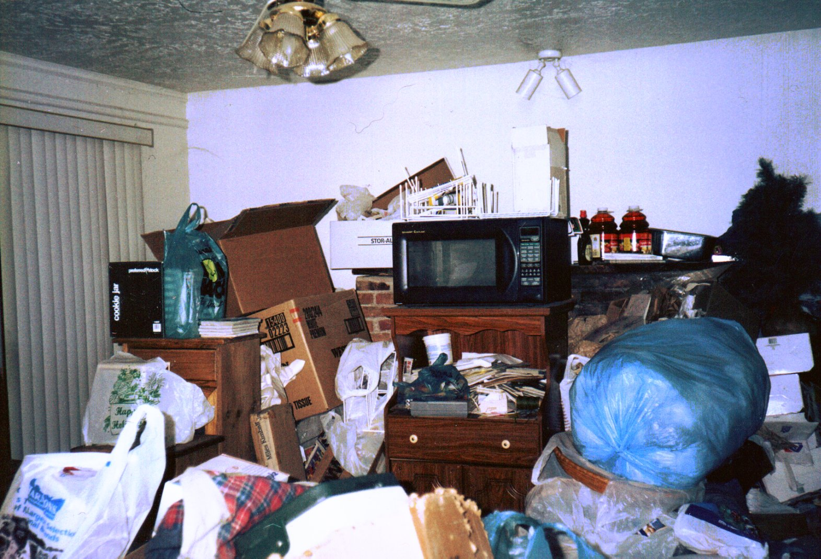
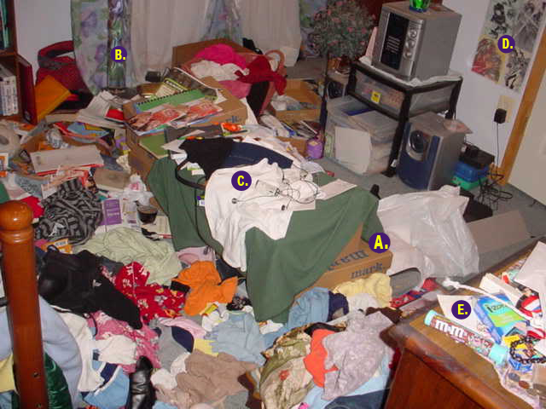
The house was always a mess

Slide 6

Who was going in there?
District Nurses
Occupational Therapists
Health Visitor
Learning Disability Team
GP
Social Care
Then… FRESH EYES, FRESH CHALLENGE……
Notes:
District Nurses visited one day a week that increased to 3 days weekly for Grandmothers personal care in the third year
OT assessment 6 times
Health visitor visited twice
Learning disability team 2
times a month
GP 24 home visits in 3 years
Social care made assessments
on three older children, no focus on
Bell ……
This went on for 3 years ..until an new District nurse went in … FRESH EYES, FRESH CHALLENGE……….

Slide 7
New District Nurse identified ……
Hoarding
Grandmother was bed bound
Daughter with Learning Disabilities
Daughters new partner had mental health needs
Daughter and new partner spending time in bed with overt sexualised behaviour between them
Oldest child caring for the other children
Bell was in her pushchair all the time
Notes:
Key – everyone thought bell was a baby not 3 ½ years
Over crowding / clutter / hoarding
Grandmother was bed bound needing care 7 days a week (pressure sores, leg ulcers, emaciated)
Daughter with LD reported she had a bad night with grandmother and was tired
New partner had mental health needs and had been homeless
Both mother and new partner were in bed at 3pm, overt sexualised behaviour
The oldest child came home from school alone with the other’s
Bell was JUST in her pushchair

Slide 8
Family Dynamics
Daughter
Learning disability
New partner –
History of adult and child sexual abuse and was on the sex offender register
Grandmother –
Emaciated with infected leg ulcers and non concordant with treatments
Main carer for family prior to stroke
Notes:
The new boyfriend had a record of adult and child sexual abuse , had been in prison was on the sex offender register
The enquiry showed he had sexually abused the grandmother while supporting her personal care
The 10 year old spoke of fighting him off she had threated the to call the police.. she protected the children
The mother of the children thought she was in love with the new partner ……
Was being starved due to daughter inability to cook
Leg ulcers were infected and she had pressure sores
Had poor compliance with medication due to daughter inability
Grandmother was main carers for daughter and her 4 grandchildren before she had a stroke
GP was involved post stroke but did not perceive she was unable to cope
…it had not been reassessed by children services as no professional visiting deemed it relevant to refer to children's social care

Slide 9
Bell was in her pushchair
This had gone unnoticed for 3 years
There was a blank expression on her face
She had no cot to sleep in
She was dirty and unkempt her care was performed by older sister
She was malnourished
She was not talking or walking
Her legs were contracted
No professional had considered referral to Children Social Care as she was invisible to professional curiosity
Notes:
This had gone unnoticed for 3 years, professional thought she was a baby ………. She had a blank expression which professionals had walked past for the 3 years when visiting the house as they were focused on the Grandmother….
Bell had no cot to sleep in, the push chair was all she knew ,
Bell was fed in the push chair
Bell has infrequent baths which her older sister (9) undertook
Bell did not talk, did not walk,
Bells legs had contractures, her skin was ingrained in dirt
Bell looked like an emaciated 6 month baby……
No-one professional had made a referral to children social care as Bell was invisible to professional curiosity

Slide 10
Group Discussion
How would this be addressed?
What are the challenges and barriers?

Slide 11
Identifying Neglect / self neglect
Hardest form of abuse to identify
Historically it is not seen as abuse
It is often identified with other forms of abuse
In adults it is in the form of self neglect and hoarding
Notes:
Mental illness and suicidal is higher in children whilst suffering neglect, abuse and harm
It’s essential they receive appropriate multi agency assessment and are provided with right and suitable support from an holistic perspective to maintain their wellbeing
(Norman, 2012; Independent Inquiry Into Child Sexual Abuse, 2017).
Self Neglect can have a variety of key episodes – fire deaths, drugs and alcohol abuse, infections from poor tissue viability, impact of mental distress or learning disability, untreated diabetes

Slide 12

Multi –agency working with adults who self neglect

Slide 13
Self-Neglect Definition
Lack of self-care
Lack of care of one’s environment
Refusal of services that would mitigate risk of harm
https://www.dorsetforyou.gov.uk/media/218335/Self-neglect-and-Hoarding---Guidance-for-agencies/pdf/Self_Neglect_and_Hoarding_V2_0_Final.pdf
Self Neglect tool kit - https://www.dorsetforyou.gov.uk/media/218427/Self-neglect-toolkit/pdf/Self_Neglect_Toolkit.pdf
Notes:
Lack of self-care – neglect of personal hygiene, nutrition, hydration, and health, thereby endangering safety and well-being, and/or
Lack of care of one’s environment – squalor and hoarding, and/or
Refusal of services that would mitigate risk of harm
People may be unwilling and/or unable to address issues relating to self-care and care of their immediate environment.
Lack of self-care (alcohol abuse, poor nutrition, neglect of hydration and ill-health) – 54%
Lack of care of environment (squalor, hoarding, fire risk) – 32%
Refusal of services – 58%
All three elements – 34%
History taking – explore questions asking ‘why’
Professional Curiosity
Making safeguarding personal (Autonomy & life style choice) – open and transparent around the risks to the individual
Engagement – different approaches work with different people, use of advocates, maintaining contact, avoid closing cases
Mental capacity – clear guidance for staff regarding people with capacity who refuse services and are at risk
Consider needs of Carers

Slide 14
Six Adult Safeguarding Principles
EPPPA
Empowerment
Protection
Prevention
Partnership
Proportionality
Accountability
Emphasis on wellbeing alongside safety and prevention
Notes:
Making safeguarding personal
In adults is person led but children's welfare is paramount
Is outcome focused
Engages the person and enhances involvement, choice and control
Improves the quality of life, wellbeing and safety
Safeguarding enquiries must not simply be see in the context of a Section 42 enquiry, but must consider the wider implications for safeguarding activity and the quality of care spectrum.
Providers need to offer ongoing support to translate the principles into practice.
Staff are supported to balance sometimes conflicting principles.
People are included within discussions around risk and are supported in making decisions – Mental Capacity Act
Wellbeing is to be considered alongside safety Organisational culture needs to supports a person centred approach
Professionals to adopt positive approaches to working with risk
Information and advice is promoted including rights of people to advocacy support.
Mental Capacity Act is key to Making Safeguarding Personal.

