Slide 1
Understanding Attachment and the Impact on Family Functioning
Presented by Jenny Bigmore Social Work Lecturer at Bournemouth University and Mike Wootten – Third Year Undergraduate Social Work Student, Bournemouth University.

Slide 2
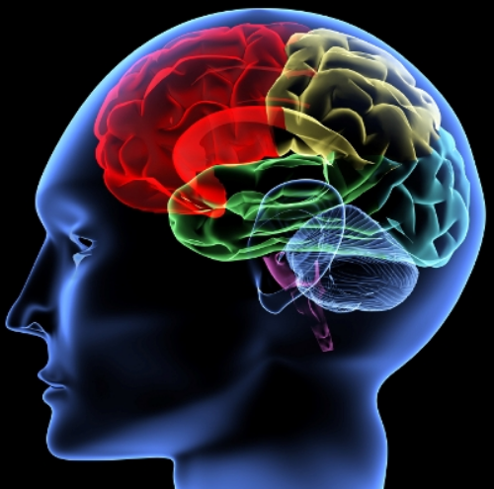
Introductions
This will be an interactive experience!

Slide 3
What and Why?
Findings from Serious Case Reviews
A Family Approach
How do we learn to parent?
The Child’s Voice.
Behaviour is a child’s language
What are they trying to tell us?
We are very good at gathering information but analysis of the meaning of that information can let us down.
What neuroscience is telling us.

Slide 4
To attach is to survive
Human babies are helpless and their survival depends on attuned caregiving.
Attachment behaviour is survival behaviour
Human babies develop an internal working model of attachment behaviour which forms a blueprint for the future.
In children their internal working model is reflected in the style of their attachment behaviour to caregivers and has characteristics which can be classified

Slide 5
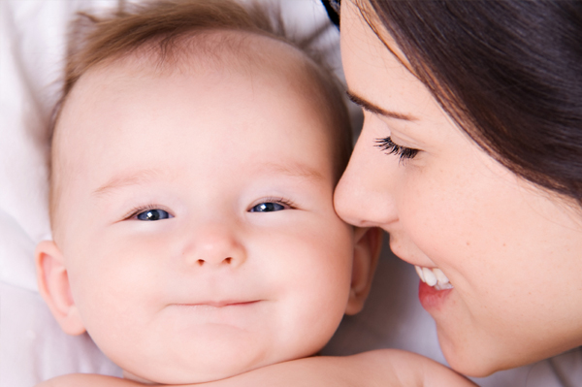

Attachment theory – is not just about babies!
Attachment is the emotional bond that develops from the interactions between a child, his/her carer and the subsequent impact their experiences have on relationships with other people.

Slide 6

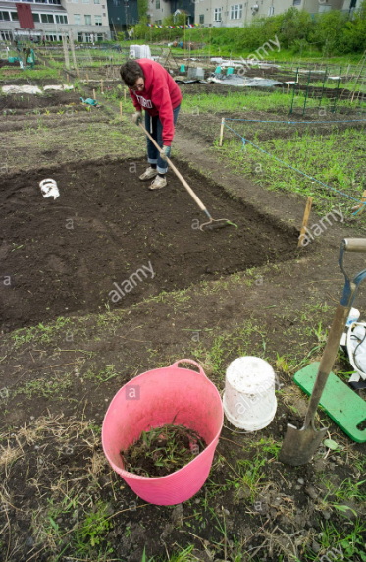


Prepare the ground
Plant the Seed
Feed
Water

Slide 7
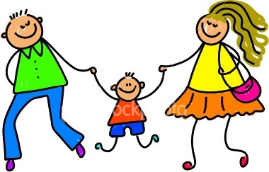
Secure Internal Working Model
Loving
Caring
I’m wanted
Sensitive
I’m competent
I’m loved
I’m good
I’m worthwhile
Responsive
Trustworthy
Safe
Worth
Living
Enjoyable

Slide 8
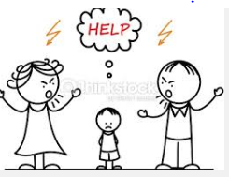
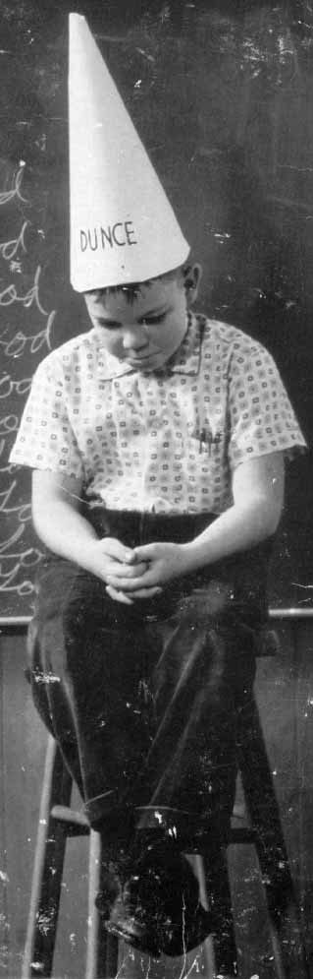

Insecure Internal Working Model
Untrustworthy
I’m Bad
Inattentive
I’m Helpless
I’m unwanted
I’m unbelievable
Unresponsive
Hurtful
Unsafe
Not worth Living
Painful

Slide 9
Insecure Attachments -associated with unresponsive caregiver and negative outcomes for the child
Insecure Avoidant: Avoidant reaction to care giver’s attempts at attunement. Associated with angry or defiant presentation in children.
Insecure ambivalent: Fluctuates between anger towards the parent and rejecting and wanting closeness. Associated with children who are emotional and overwhelmed by anxiety.
Insecure disorganised: Show confusing contradictory attachment behaviour. The child may show an angry outburst and then be dazed or try to escape. The child may have a ‘frozen watchfulness’ of the maltreated child. The child may sit on caregiver’s lap but be physically stiff and with eyes averted from the carer.

Slide 10

The Effects of Insecure Attachment
Attachment Disorders
“I was treated badly”
Abuse & Neglect
Multiple Disruptions
Negative Responses
“Others treat me badly” – parents, teachers, peers
Punishment, rejection, reinforce IWM
Negative Working Models
“ I am bad, unlovable”
Unsafe, unreliable
Behavioural Problems
“ I will act badly”
Aggressive
Oppositional
dishonest

Slide 11

The Elephant in the room

Slide 12
Assessment of parenting and the care –giving system
Core dimensions intrinsic to all parents
Childhood attachment system
1. The parent’s state of mind regarding their own childhood attachments.
2. The parent’s degree of resolution regarding loss and trauma.
The spousal/pair bonding system
3. The state of the marriage/adult sexual partnership
The affiliative/wider support system
4. Family and Friends and community resources
The care- giving system
5. The meaning of the child to the parent.

Slide 13
These dimensions modify the function of parents
1.Modifiers Type 1. intra or interpersonal. Mental or physical illness Learning Disability Substance Misuse Domestic Abuse Reconstitution of the family Adolescent motherhood Type 2 cultural/socio- economic Socio economic systems – cultural norms about parenting
2. Integration – ability to use information in order to modify care giving behaviour.
3. The child. – characteristics of the child. ( Farnfield 2007)

Slide 14
Mental and Physical illness
Mental illness does not mean parents cannot bring up their children.
The majority of parents who maltreat their children do not warrant a psychiatric assessment although neglecting and physically abusing parents show a higher than average incidence of depression.
Severe cases of maltreatment are more likely to involve a psychiatric disorder.
Disorganised attachment in the child is associated with distorted thought processes in the parent.
A protective factor can be insight into the nature of their mental illness.
Physical illness or disability is only a threat to care-giving if it is so severe that parenting is no longer viable.
In attachment terms the main issue is whether being a “young carer” has led to role reversal.

Slide 15
Learning Disability
Learning disability is not a threat to the care-giving environment unless the ability of the parent to develop a “theory of mind” about their children is so severely compromised that the child is treated as a doll-like object (meaning of the child).
In more moderate cases the main issue is the ability to transfer skills learned in one domain of parenting to another.

Slide 16
Substance Misuse
Alcoholism and drug misuse may impact on spousal and wider support systems.
Both issues may be an attempt to self- medicate mental health problems including unresolved loss and trauma. Research shows that children are potentially at more risk once the parent is no longer able to manage their underlying emotional problems.
A major problem is that the care giving environment becomes unsafe for the child through violence, crime and neglect that form part of the sub culture

Slide 17
Care Giving Environment
Rarely a single cause of child abuse
It is the interaction between child, family and parental elements/experiences etc. that determine the care-giving environment in any particular case.
Problems in one dimension may exacerbate problems in others leading to a cascade of factors.

Slide 18
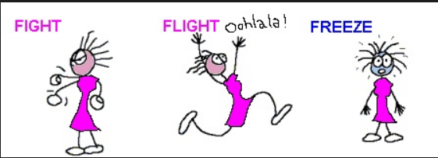
Stress Response

Slide 19
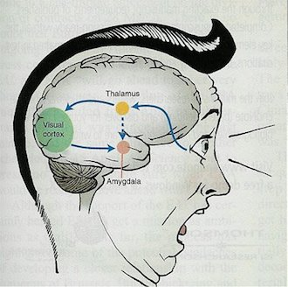
How exposure to early adversity affects the developing brain.
MRI scans show marked differences in the brain structure of the amygdala which is the brain’s fear response centre in those who have experienced exposure to early diversity/stress.

Slide 20
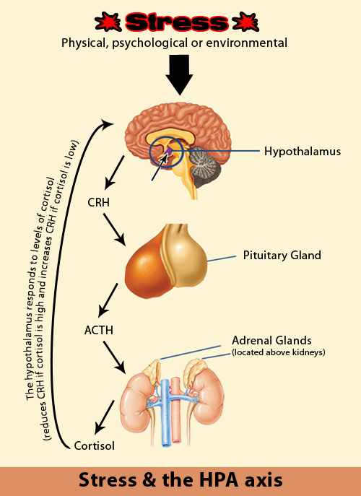
HPA Axis
Fear or stress set off a chain reaction which invokes an interaction between the nervous system and the endocrine system. This is known as the HPA axis
Notes:
Endocrine system – glands which secrete hormones

Slide 21

Walk in forest
See a bear
Hypothalamus sends message to
Pituitary gland
Sends signal to adrenal gland
Release the stress hormones!
Adrenaline – Cortisol
Heart starts to pound
Pupils dilate
Airways open up
Ready to fight the bear or run away
Wonderful if you are in a forest and there’s a bear……..
The problem is when the bear comes home every night – the system is activated over and over again!
It goes from being an adaptive or life saving response to a maladaptive or health damaging one.
Children are especially sensitive to this repeated stress activation because their brains and bodies are just developing.
This inevitably impacts on their attachment styles, behaviour and relationships both as a child and moving on into adulthood

Slide 22
Conclusions
So what does knowledge of attachment theory mean for practice?
Findings from serious case reviews must inform policy and practice.
Responsive – not – Reactive
Work Together in a Whole Family Approach

Slide 23
Recommended Resources
How childhood trauma affects health across a lifetime
https://www.ted.com/talks/nadine_burke_harris_how_childhood_trauma_affects_health_across_a_lifetime?referrer=playlist-how_does_my_brain_work#t-932864
Archer, C. Drury C and Hills, J. (2015) Healing Hidden Hurts – Transforming attachment and Trauma Theory into effective Practice with Families, Children & Adults. Jessica Kingsley.
Farnfield, S. (2008) A Theoretical Model for the Comprehensive assessment of Parenting. British Journal of Social Work.

